Slide 1


SNS COLLEGE OF ENGINEERING
Kurumbapalayam (Po), Coimbatore – 641
AN AUTONOMOUS INSTITUTION
Accredited by NBA – AICTE and Accredited by NAAC – UGC with ‘A’ Grade Approved by AICTE, New Delhi & Affiliated to Anna University, Chennai
DEPARTMENT OF COMPUTER SCIENCE AND ENGINEERING
Mini project
Title of the Project : VIRTUAL MOUSE USING PYTHON
Guide
Mr. Karthikeyan.K
Assistant professor / CSE
Department of CSE
SNSCE
Coimbatore-107
Candidates with register no :
NANDHINI.C 19CECS021
NARAYANAN.M.S 19CECS022
POZHIL.K 19CECS024
PRAGADEESHWAR.R 19CECS025

Slide 2

Objective:
The goal is to manage computers and their devices with gestures rather than pointing and clicking or mouse or touching a display directly.
Increasingly we are recognizing the importance of human computing interacting(HCI), and in particular vision-based gesture and object recognition
Maintenance of the virtual mouse is easy and cost efficient.
Reduce cost hardware.
It has End less life spam.

Slide 3

Empathy:
Many people are struggling to use physical mouse in modern environment because it does not work with many surface so, we are decided to implement a virtual mouse.
Performance various depending on the environment Mouse has limited functions even in present operational environment.
To design virtual mouse which detects hand
gestures patterns instead of physical mouse.
The utilization of virtual mouse appears in space saving situations or in movement situation.

Slide 4

Define:
The project provides a new approach for controlling mouse movement using a real time Web camera.
We are using two packages in python Opencv and Mediapipe.
It has automatically detect the hand by using hand tracking module after that when we move our hand the cursor move spontaneously
We have developed gesture to control increasing or decreasing the volume.
Major approaches consists of adding more buttons are changing the positions of the tracking ball of the mouse.
Basically we use colored tips for detection which are captured by Webcam.
Here, the colored fingertip acts as an object which the Webcam senses.
The Webcam is positioned such that it recognizes the moment
of finger tips and performs the operations of mouse

Slide 5
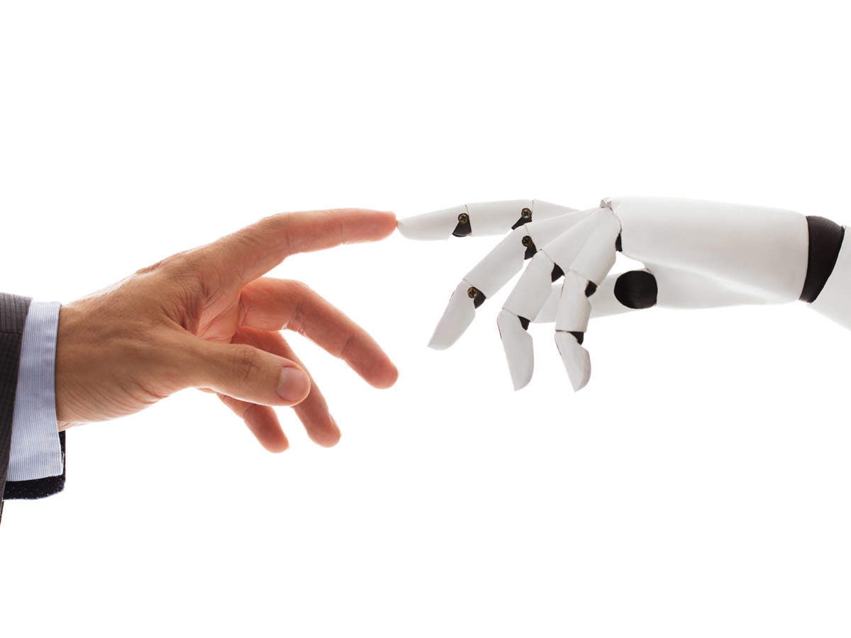
Ideate:
We have different types of solutions
Divergent Ideas:
1) Light pen
2) optical mouse
3) Hologram
4) Touch Mouse
Convergent Idea:
1) Virtual Mouse

Slide 6
METHODOLOGY:
Capturing the image and recognizing the human hand
Position of the hand is detected
Gray scales images are converted
The cursor moves accordingly
1
2
3
4

Slide 7
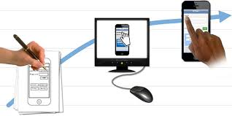
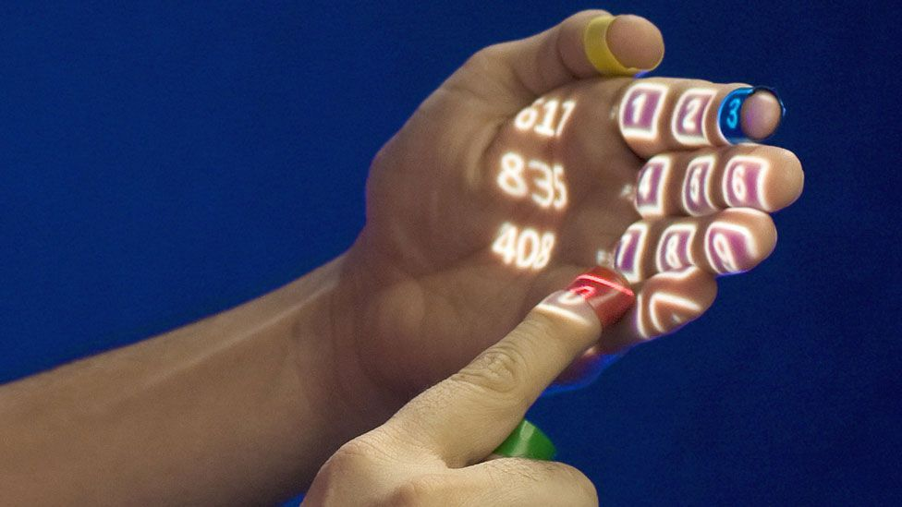
Prototype:

Slide 8
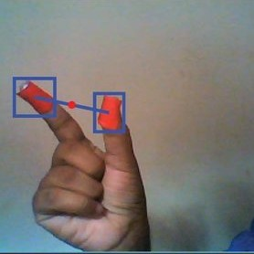
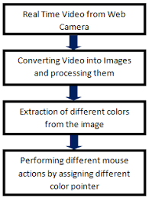
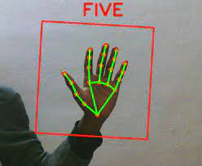
Testing:

Slide 9
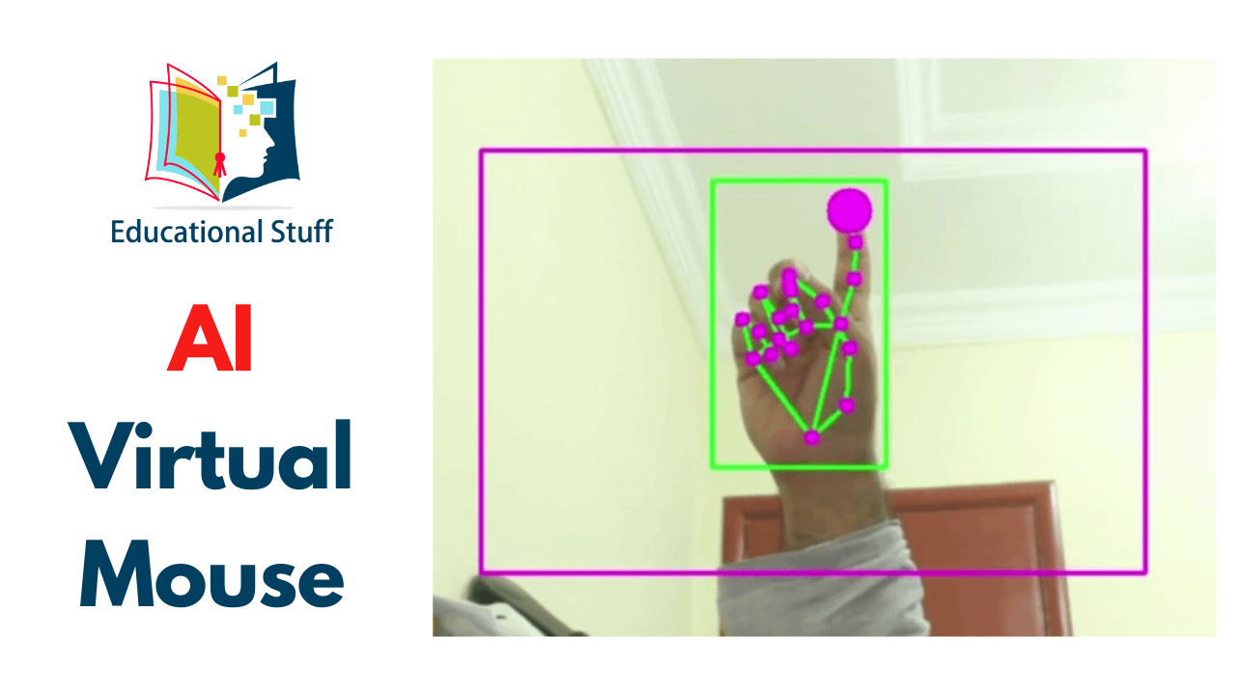
Design and Photo:
Input Image
Image Resize
Segmentation
Denoise
Compute Center
Get radius
Get finger tips
Control Mouse

Slide 10

Advantage:
The main advantage of using hand gestures is to interact with computer as a non-contact human computer input modality.
Reduce hardware cost by eliminating use of mouse.
Convenient for users not comfortable with touchpad.
The framework may be useful for controlling different types of games and applications dependent on the controlled through user defined gestures.

Slide 11
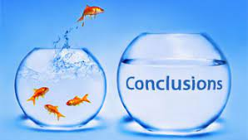
CONCLUSION:
We are developing a system to control the mouse cursor using a real-time camera.
This system is based on computer vision algorithms and can do all mouse tasks.
However, it is difficult to get stable results because of the variety of lighting and skin colors of human races.
This system could be useful in presentations and to reduce work space.

Slide 12

REFERENCE:
Chhoriya P., Paliwal G., Badhan P., 2013, “Image Processing Based Colour Detection”, International Journal of Emerging Technology and Advanced Engineering, Volume 3, Issue 4, pp. 410-415
Rhitivij Parasher,Preksha Pareek ,”Event triggering Using hand gesture using open cv”, volume -02-february,2016 page No.15673-15676.
Student, Department of Information Technology, PSG College of Technology, Coimbatore, Tamilnadu, India,”Virtual Mouse Using Hand Gesture Recognition ”,Volume 5 Issue VII, July 2017

Slide 13



